Slide 1



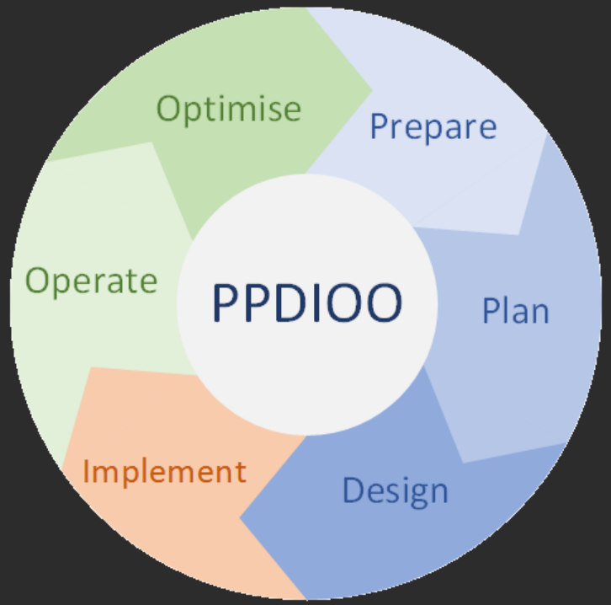
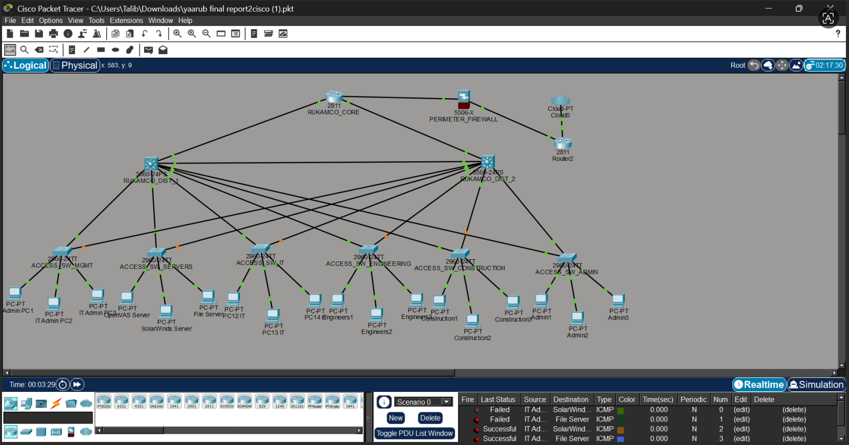
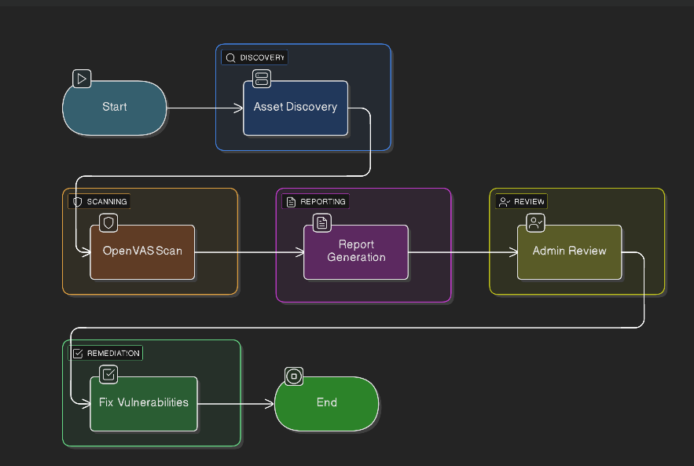

View my Profile
Project Title:
Designing, Implementing and Securing Network Infrastructure with Vulnerability Scanning for Rukamco LLC.
Department of Computing
& Electronics Engineering
Student ID & Name:
22f23214 – Yaarub Talib Al-yarobi.
Supervised by:
Mr.Muhammad Sohail.
Introduction
Scope (Aim, Objectives & Stakeholders)
Methodology & its Rationale
Modern organizations depend on secure and efficient network infrastructures to support communication, data sharing, and operations. Rukamco LLC faced issues such as lack of network segmentation, weak security controls, and absence of continuous monitoring. This project proposes a structured, secure, and scalable network design integrated with vulnerability scanning and monitoring tools to enhance performance and cybersecurity.
Aim:
To design, implement, and secure a scalable network infrastructure for Rukamco LLC with integrated vulnerability scanning and centralized monitoring.
Objectives:
Analyze current network weaknesses.
Design hierarchical network (Core, Distribution, Access)
Implement VLAN-based segmentation.
Configure firewall and access control policies.
Integrate vulnerability scanning tools (OpenVAS, Nmap).
Enable centralized monitoring (SolarWinds).
Improve network performance, security, and scalability.
Stakeholders:
IT Administrators.
Network Engineer (Project Developer).
Employees (End Users).
Name of the Methodology: PPDIOO (Prepare, Plan, Design, Implement, Operate, Oiptimze).
Stages:
Prepare: Identify business requirements, network problems, and security needs.
Plan: Analyze current infrastructure and define technical requirements .
Design: Create logical and physical network design (VLANs, topology, IP scheme) .
Implement: Configure routers, switches, firewall, and security tools .
Operate: Monitor network performance and ensure stable operation .
Optimize: Improve performance, fix vulnerabilities, and enhance security.
Rationale:
Structured approach for network lifecycle.
Supports scalability and security.
Enables continuous monitoring and improvement.
Suitable for enterprise-level infrastructure.
Supports proactive problem detection and optimization.
Resource Plan
System Diagrams
Real Time Vulnerability Scanning with OpenVAS:
Prototypes/Screen Designs
Hardware:
Routers.
Switches.
Firewall Appliance.
Workstations.
Software:
OpenVAS.
Wireshark.
SolarWinds.
Packet Tracer.
Windows/Linux OS.
Libraries / Tools:
Nmap (network scanning).
Python (automation scripts).
Network protocols (TCP/IP, VLANs, ACLs).
Documentation:
Microsoft Word, Cisco Packet Tracer (for Network design(Logical & Physical),IP addressing scheme, Configuration files (VLANs, ACLs, routing).
Key References
Cisco, 2024. 2024 Cisco Cybersecurity Readiness Index. [Online] Available at: https://newsroom.cisco.com/c/dam/r/newsroom/en/us/interactive/cybersecurity-readiness-index/documents/Cisco_Cybersecurity_Readiness_Index_FINAL.pdf?utm_ [Accessed 11 november 2024].
ciscozine, 2025. The PPDIOO network lifecycle. [Online] Available at: https://www.ciscozine.com/the-ppdioo-network-lifecycle/ [Accessed 21 december 2025].
cybrary, 2025. Vulnerability Assessment using OpenVas - First Scan. [Online] Available at: https://www.cybrary.it/blog/vulnerability-assessment-using-openvas-first-scan?utm_ [Accessed Tuesday december 2025].
Framework, N.C., 2024. Cybersecurity Framework. [Online] Available at: https://www.nist.gov/cyberframework?utm_ [Accessed monday december 2025].
ijrpr, 2022. Network Traffic Analysis Using Wireshark. [Online] Available at: https://ijrpr.com/uploads/V4ISSUE11/IJRPR19300.pdf?utm_ [Accessed Tuesday december 2025].

